Slide 1









Content
FHQ
WEB PROGRAMMING
The best solutions are often simple, yet unexpected.
Final Project:
“Departmental Store Management”
Julian Casablancas
Students:
Trịnh Minh Anh
Lê Đức Thịnh
17110003
17110076
Lecturer: Mr. Nguyễn Đức Khoan
04
03
05
Software
architecture
Advanced
functions
Database
diagram
06
02
01
Demonstration
Why PLM?
Basic functions
07
Q & A
Notes:
Waiting screen

Slide 2
Content
FHQ
WEB PROGRAMMING
Final Project:
“Departmental Store Management”
Students:
Trịnh Minh Anh
Lê Đức Thịnh
17110003
17110076
Lecturer: Mr. Nguyễn Đức Khoan
04
03
05
Software
architecture
Advanced
functions
Database
diagram
06
02
01
Demonstration
Why PLM?
Basic functions
07
Q & A
Notes:
Waiting screen

Slide 3
4
Demo
3
ERD & Class
WEB PROGRAMMING
Final Project:
“Departmental Store Management”
2
Use case
1
Introduction
01
Students:
Trịnh Minh Anh
Lê Đức Thịnh
17110003
17110076
Lecturer: Mr. Nguyễn Đức Khoan
Notes:
Waiting screen

Slide 4
1. Introduction
4
Demo
3
ERD & Class
DATABASE MANAGEMENT SYSTEM
Final Project:
“Departmental Store Management”
2
Use case
1
Introduction
01
Students:
Trịnh Minh Anh
Lê Đức Thịnh
17110003
17110076
Lecturer: Mr. Nguyễn Thành Sơn
Notes:
Waiting screen

Slide 5

1.1 Definition
1. Introduction
1.1 Definition
02

Slide 6




1.1 Definition
Definition
1. Introduction
Website
Administrator
Staff
Customer
02

Slide 7
Definition
Website
Administrator
Staff
Customer
Web Technology
Full Control
Work effectively
Convenient shopping
03

Slide 8
Definition
Website
Administrator
Staff
Customer
Web Technology
Full Control
Work effectively
Convenient shopping
03

Slide 9
Definition
Website
Administrator
Staff
Customer
Web Technology
Full Control
Work effectively
Convenient shopping
03

Slide 10
1.2 Reasons to choose the topic
Definition
Website
Administrator
Staff
Customer
Web Technology
Full Control
Work effectively
Convenient shopping
03

Slide 11
1.2 Difficulties
04

Slide 12
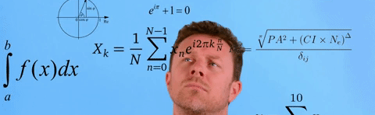
2. Use case
REALLIFE
It is sure that your imagination might not work out!
What we do not know
What we can do
05

Slide 13

2. Use case
1.1 Definition
08

Slide 14

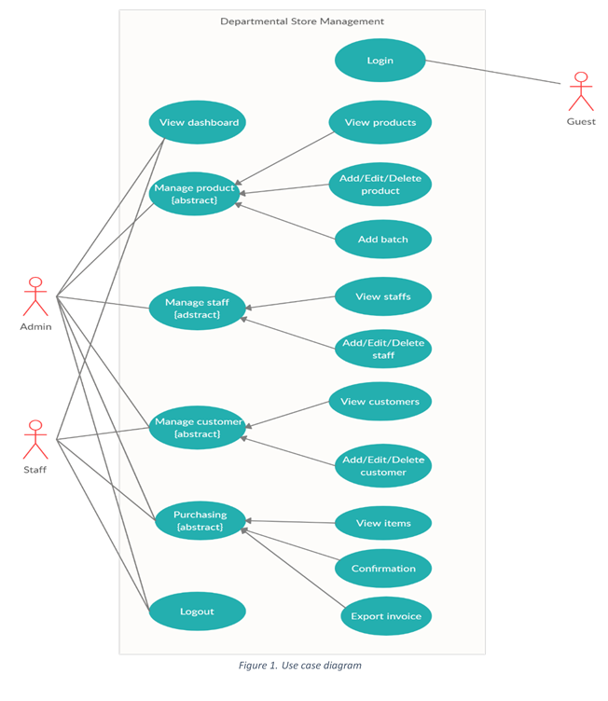
3. Advanced functions
07
1. Why PLM?
Notes:
Generally, this software provides the administrator with basic functions, such as:

Slide 15

3. ERD & Class
1.1 Definition
08

Slide 16



4. Demo
09

Slide 17
4. Workflow
10
Processing
Database
View

Slide 18
View
Processing
Database
10

Slide 19


View
Processing
Database
Function
Triggers
SP
Constraint
10

Slide 20

Q & A
Processing
View
Database

